Slide 1
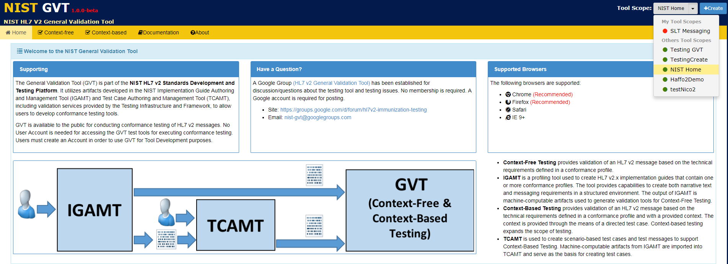
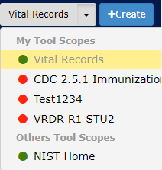

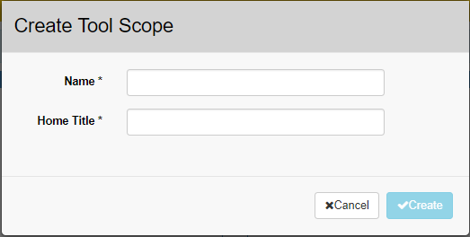
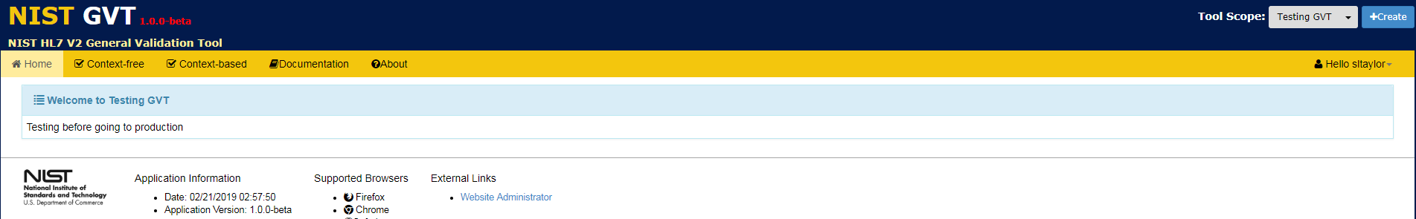
Creating a Tool Scope
The Tool Scope is used to organize testing tools into user-defined categories. A Tool Scope creator can apply any Tool Scope name that indicates the category of the tools being created.
A Tool Scope may be Private (available for use only by the registered GVT User who created the Tool Scope) or Public (available for use by all GVT Users).
When a registered user logs in to GVT, the dropdown Tool Scope menu displays “My Tool Scopes” (i.e., both Private and Public Tool Scopes created by the logged in registered user who created the Tool Scopes) and “Others Tool Scopes” (i.e., Public Tool Scopes created by users other than the logged in registered user).
1
Click +Create.
Enter Tool Scope Name and Home Title
3
2
Click √Create.
4
Tool Scope Name and Home Title are displayed.

